Slide 1
House Price Prediction
Machine Learning Foundation Project

Slide 2
Context
The sale price of a house depends on the location of the house, square footage of a house, year built, year renovated, number of bedrooms, number of garages, etc.
The aim of this project is to:
predict the sale prices for houses based on property data
make a model which can give us a good prediction on the price of the house based on other variables
to achieve an accuracy score of 85%+
We will use Linear Regression for modelling as the response variable is continuous and see if it gives us a good accuracy or not.

Slide 3
Overview of the Dataset
Our dataset comprises of:
81 explanatory variables (38 numeric and 43 categorical). Few mentioned below.
Numerical Variables
SalePrice - the property's sale price in dollars. This is the target variable that you're trying to predict.
MasVnrArea, GrLivArea , TotalBsmtSF, FullBath, TotRmsAbvGrd
GarageArea, GarageCars
Categorical Variables
FireplaceQu, MasVnrType
GarageType, GarageFinish, GarageQual, GarageCond
BsmtFinType2, BsmtExposure, BsmtFinType1, BsmtCond, BsmtQual
1460 observations
5.9% missing data

Slide 4
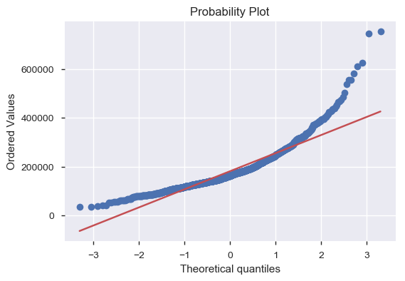
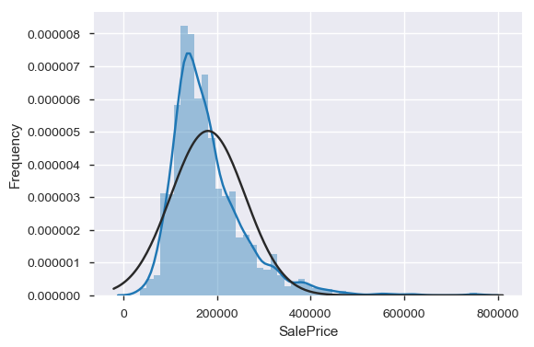
Normal distribution of SalePrice (before transformation)
The SalePrice deviates from normal distribution and is positively biased. There are lot of outliers along the higher price.
The SalePrice also does not align with the diagonal line which represents normal distribution in the probability graph.

Slide 5
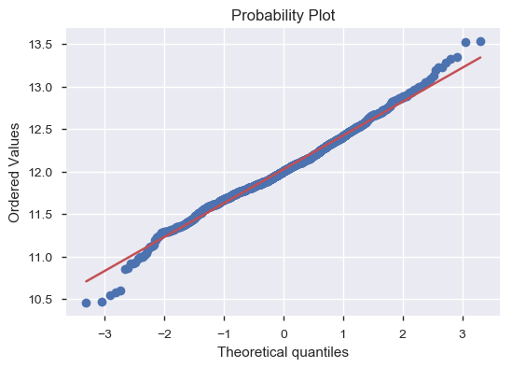
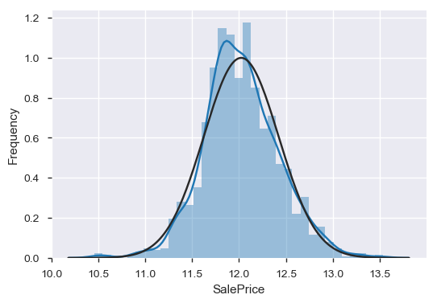
Normal distribution of SalePrice (post transformation)
We use logarithmic transformation to make highly skewed distributions less skewed and make the target variable normally distributed..

Slide 6
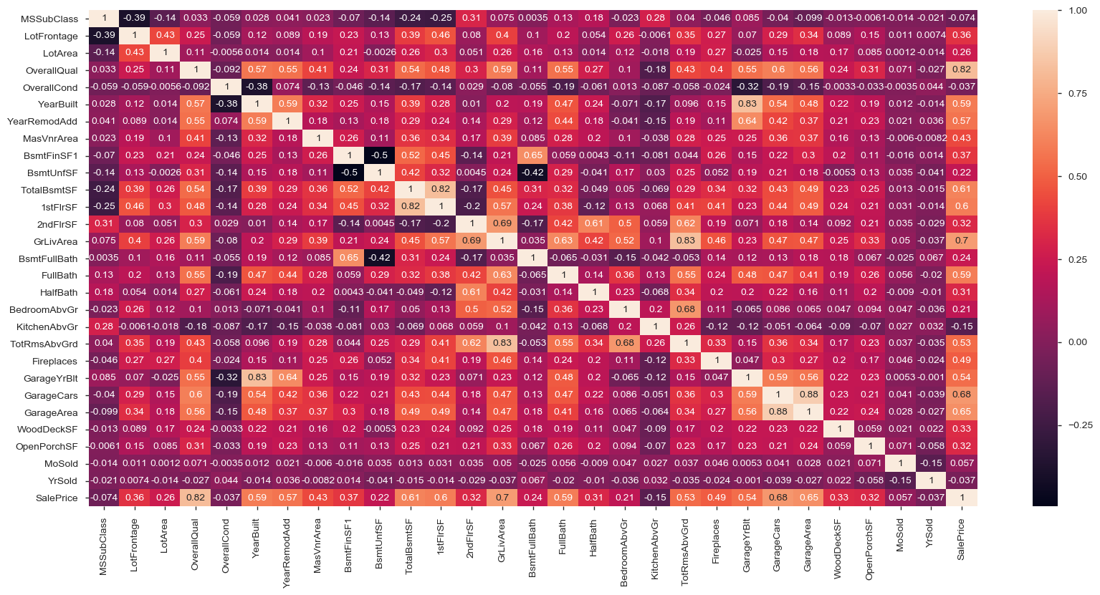
Correlation matrix

Slide 7
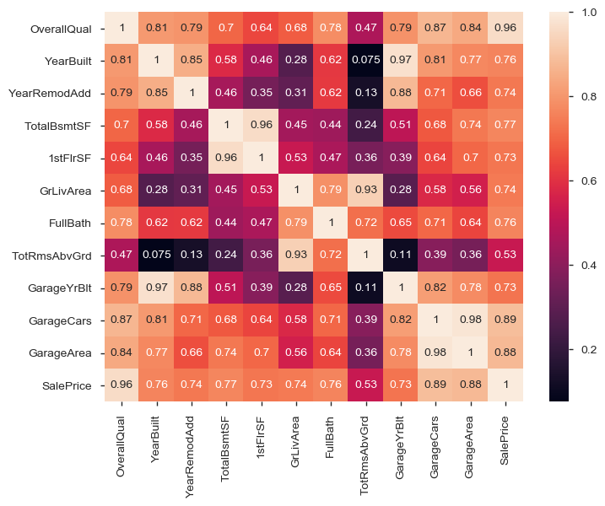
Correlation matrix of important features
We can see from the heatmap that many factors are affecting the prices of the house , like area and square feet which increase the price of the house, and even the year when it was built.
GarageCars and GarageArea have strong correlation while TotalBsmtSF and 1stFlrSF too have high correlation.

Slide 8
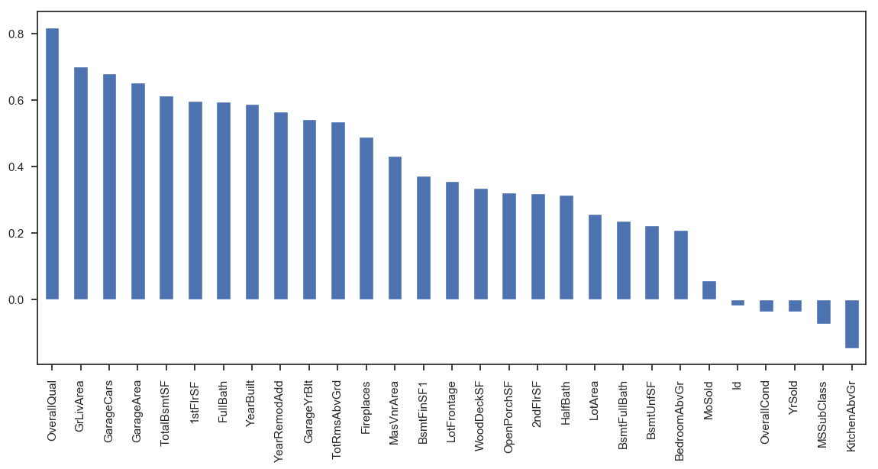
SalePrice versus Features

Slide 9
Processing the dataset
Check for percentage of missing and zero values in the dataset.
Selecting missing and zero values greater than 80% and then dropping those columns since they do not contribute to SalePrice.
Fill missing values with None for categorical values.
Replacing missing values with zero for numerical values.
The resulting dataset comprises of no null values.
Transform categorical values into numerical values for ease of modelling.

Slide 10
Modelling
Linear Regression as model validation technique
Root Mean Square Error (RMSE) as evaluation metric which tells you how concentrated the data is around the line of best fit.
Determine Accuracy of the model.
Retrain the model using the train set and predict future values for SalePrice.

Slide 11
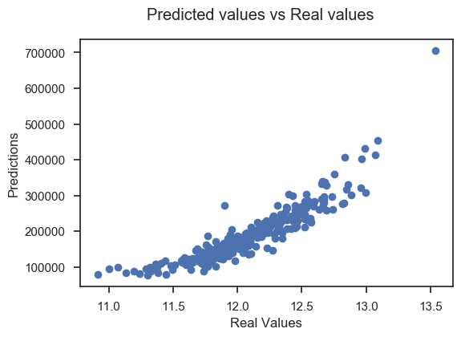
Predicted versus Real values

Slide 12
Results and Conclusion
Using Liner Regression we have managed to aim our expected accuracy of more than 85%, that is 89%.
Predicted value = 11.70901103 & Real value = 11.767187766223199
The model performance for training set: RMSE is 0.1427447185626545
The model performance for testing set: RMSE is 0.13581709860382193
The RMSE values for training and testing sets are close which means that we have built a good model.

Slide 13
References
www.Kaggle.com
www.medium.com

